Slide 1
Smart Irrigation System
Cisco Packet Tracer

Slide 2
Introduction
There are many problems faced by farmers who are farming gardens and maintenance of the plants due to the changing in environmental conditions.
Smart Irrigation System is the solution for the above problem and it is developed based on IOT.
It is a combination of software and hardware embedded with sensors, actuators that connect the network, and other topology to exchange the data and transfer it from one place to another over the cloud and internet for communication.
Smart Irrigation system consists of smart devices that automate the irrigation system that allows the farmer to automate the lawn sprinkler/ watering system according to the level of the water shown by the water level monitor, which results in turning the water drain on or off accordingly.

Slide 3
Components
Temperature Sensor – it monitor the temperature of climate
Automatic sprinkler – it automatically sprinkle the water to crop
Pressure Monitoring – it monitor and maintains the water pressure
Water level Monitor – it shows the percentage of water present in the crop
DLC 100 Home gateway
Smart phone
Motion Detector Sensor
All this process will be done in Cisco Packet Tracer

Slide 4
Working Principle
All the components are connected through the home gateway and monitor the sensors and can operate from smartphone.
Primary target is to Irrigate the field automatically when it is dry.
A conductive sensor is placed into the soil which senses the moisture level of the soil and sends feedback to the microcontroller if the soil is dry which eventually activates the relay and the pump to irrigate the soil.
Water to be controlled by water level monitoring system.
To detect the motion, we used the microcontroller device to operate.
We used WSN Network in this system.

Slide 5
Procedure
To connect the home gateway network, a registration server is required.
Connect network to smart phone and we can do physical configuration like turn on or turn off.
Home gateway provides the internet access, wireless connectivity and acts as local network.
After setting up the gateway network, next step is to connect all the smart devices to the home gateway network.
To configure the devices, select wireless adapter from network adapter.
After registering all devices to the network, we can monitor each activity in our smart phone.

Slide 6
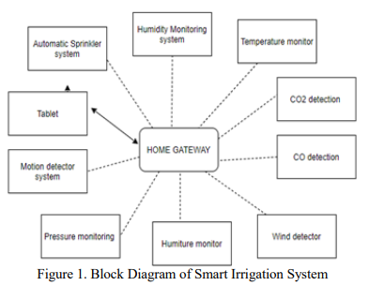
Block Diagram

Slide 7
Conclusion
A smart irrigation system is implementing using the Cisco packet tracer. A home gateway to register the devices and control them using a tablet.
All the IoT devices connected to the home gateway can be monitored manually as well as remotely by the user.
Using this smart irrigation system, we can reduce the use of water.
The network is secured because IoT devices are interconnected to the each other.

